Slide 1

License your code & pay it forward
Nami Sunami
Data Steward | TU Eindhoven
n.sunami@tue.nl
DOI: 10.53962/x6xz-1va9
This work is marked with CC0 1.0
v2025.11.11
Notes:
Nami Sunami: orcid.org/0000-0001-5482-8370

Slide 2
My journey into licensing does not make sense, except in the light of ____________.

Slide 3
My journey into licensing does not make sense, except in the light of Open Science.

Slide 5
Question: Who here works with code built by others?

Slide 6
Scenario: You shared code on a repository

Slide 7
“Can I use your work?”
Yes!
“Can I use your work?”
Yes…
….
….
“Can I use your work?”

Slide 8

CAUSE OF DEATH
FAILING TO REPLY TO REQUESTS
Photo by Kenny Eliason on Unsplash

Slide 9
No license = All rights reserved

Slide 10
When you create something, you hold a copyright.*
*If you are employed, your employer may own it.
Copyright | UU: https://www.uu.nl/en/organisation/copyright-information-office/copyright

Slide 11
You don’t want to write a legal agreement each time someone request to re-use your work
For example, an end-user license agreement
License can help you

Slide 12
Sharing code does not make sense except in the light of licensing.

Slide 13
Why should you license?

Slide 14
Licensing your work saves your time
No more answering, “Can I use your work for …?” questions.
If you have a collaborator, no need to do a consensus-building activity every time.

Slide 15
At TU/e, “we strive for maximal disclosure of results and findings”
TU/e Strategy 2030

Slide 16
Licensing your work helps others, including you in the future

Slide 17
How to decide which license to use?

Slide 18
Use choosealicense.com

Slide 19


Code or non-code?
Code
Non-code
Examples
MIT
CC BY 4.0

Slide 20
Licensing a code with non-code license is like sharing the meal without the recipe

Slide 21



Forego copyright?
SQLite
Public Domain
yt-dlp
Notes:
SQLite: https://www.sqlite.org/copyright.html

Slide 22

Copyleft or permissive?
Copyleft
Permissive
Examples
GPL
MIT
“Once open, always open”
“I don’t care”

Slide 23
Use a copyleft license if you care about how others use your code

Slide 24
Are you building on other projects? Check if it’s marked with a copyleft license.

Slide 25
When should you license?

Slide 26
As early as possible
(that is, at the start of the project)

Slide 27
How to put a license?

Slide 28
Place licensing info in LIICENSE & README files
LIICENSE
README
Good for metadata
Descriptive
Contained
Human-friendly
Easy to copy

Slide 29
What to do when I have a mix of code and content?
Place LICENSE file for code
Note the complexity in the README file
E.g., “The code is licensed under MIT, and other non-code materials are licensed under CC BY 4.0”

Slide 30

What are your questions?
License your code, because your future user could be you
Photo by ivan zakharenko on Unsplash

Slide 31
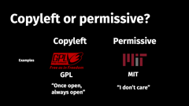
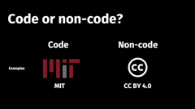

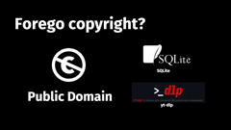
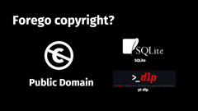
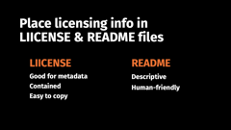
What are your questions?

